Slide 1
Senior Project
Final Presentation
Summer 2016
VIP 3.0 Team Member(s): Vladan Lalovic, Johnatan Jensen, Michael Martinez, Daniel Lopez Product Owner(s): Masoud Sadjadi, Mohsen Taheri, Maral Kargarmoakhar
School of Computing and Information Sciences Florida International University

Slide 2
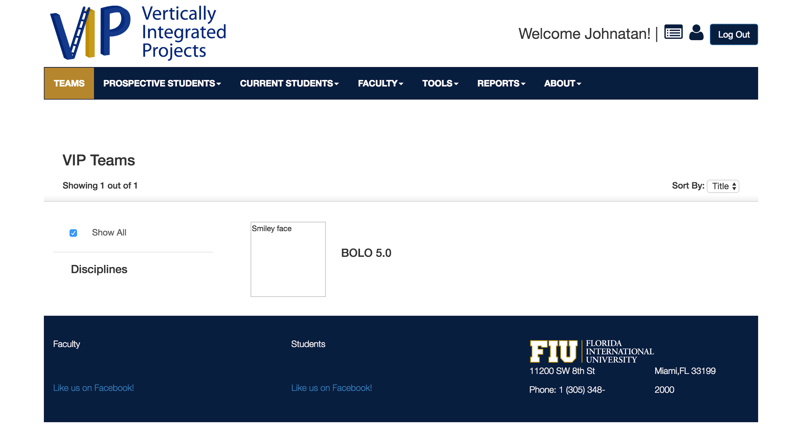
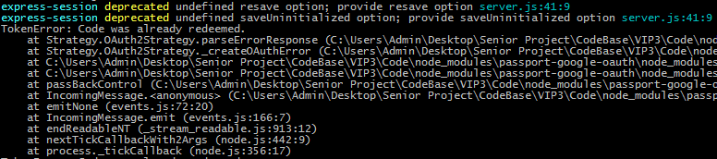
PROBLEMS with VIP 2.0
User’s cant communicate with each other.
Website is mostly Static & Non-Functional.
Searching for projects is slow, and not user friendly.
No “live” testing environment for new code.
No way to track status of existing bugs.
No Project Filters
Unstable Code

Slide 3
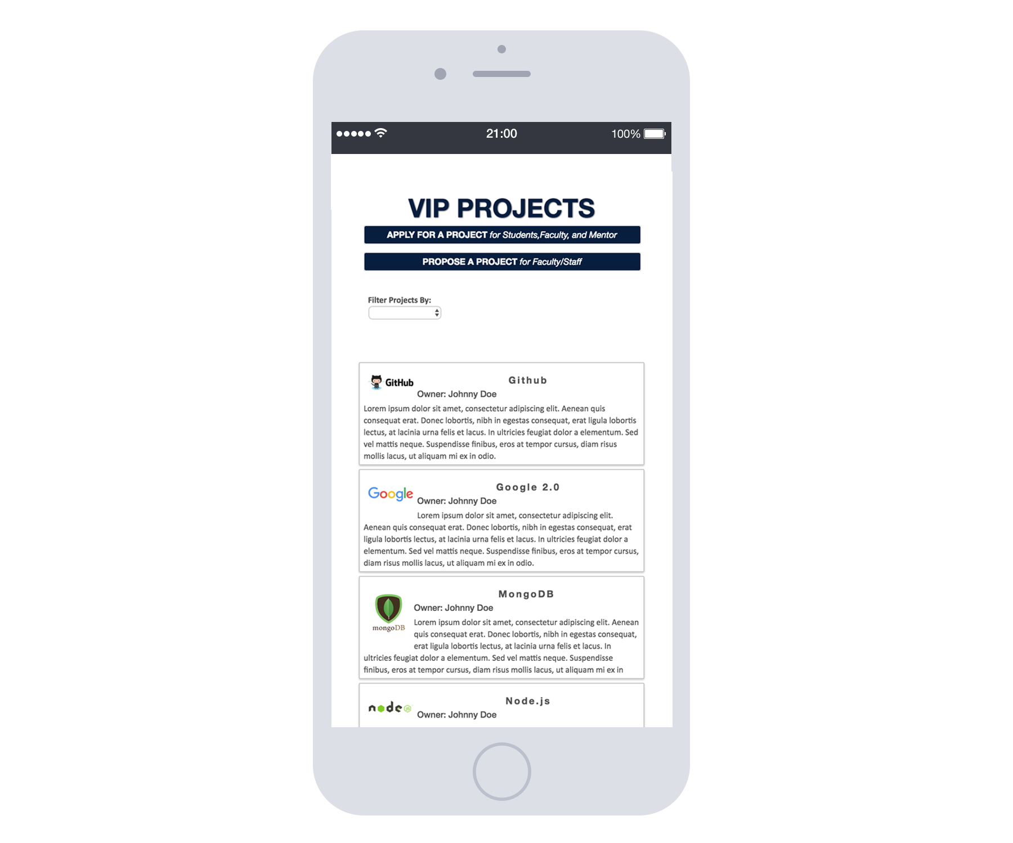
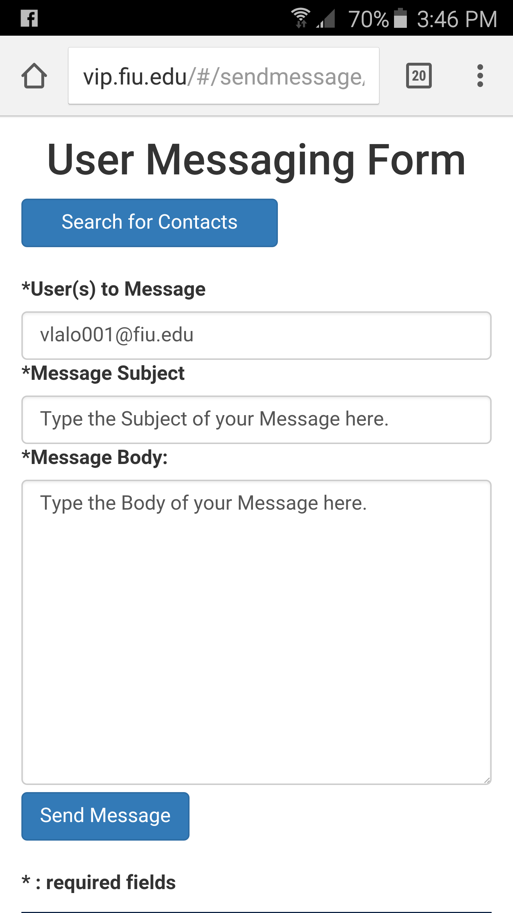
VIP TODAY: Messenger

Slide 4
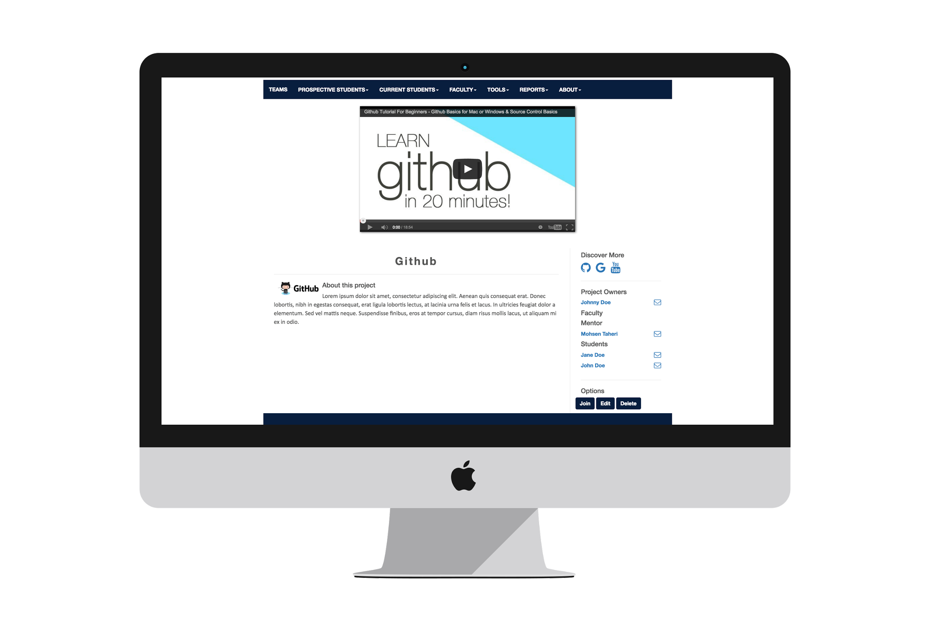
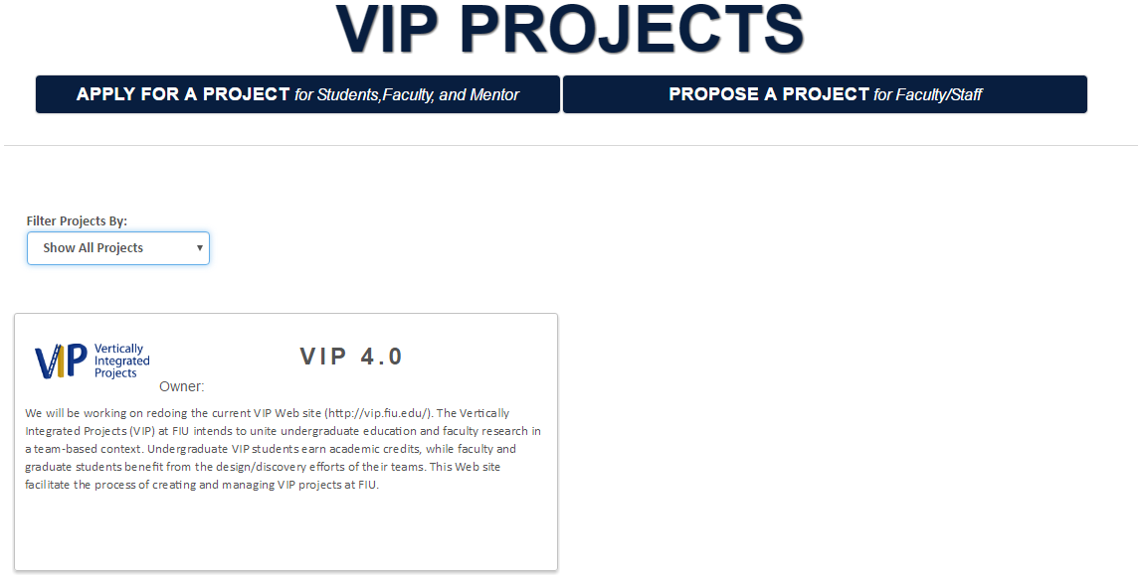
VIP TODAY: Project Filters

Slide 5
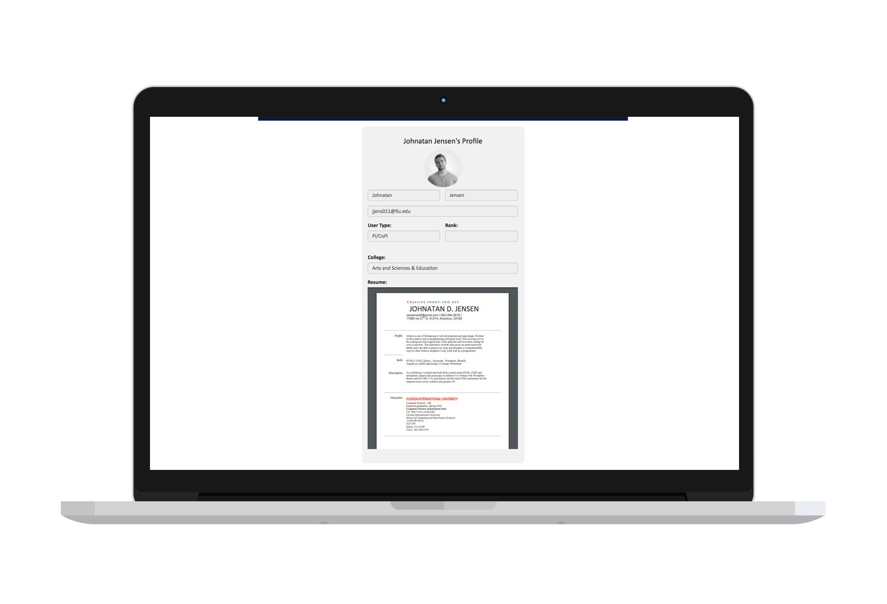
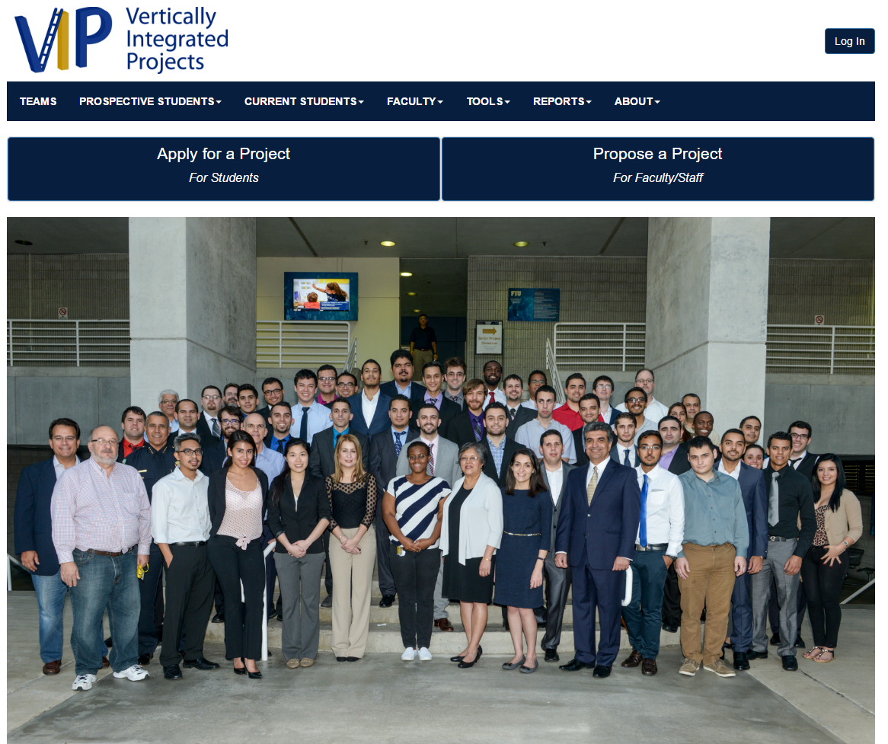
VIP TODAY: Server Stability

Slide 6
USE CASE DIAGRAM

Slide 7
MINIMAL CLASS DIAGRAM

Slide 8
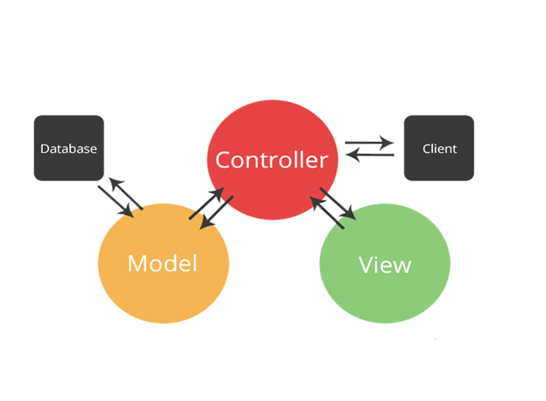

SYSTEM DESIGN: ARCHITECTURE
SOFTWARE
MVC
HARDWARE
CLIENT-SERVER

Slide 9
USER STORIES
UserStory #1078 - Messaging System for Users
UserStory #1080 - Filters for the Projects/Teams page
UserStory #1025 – Creating/Maintaining the Development Server
UserStory #1026 - Fixing Issues with Existing Features & Crashing

Slide 10
User Story #1 - Messaging System for Users
My most important user story!
Why? Fast and Reliable Communication in Projects is essential to the projects success!
Problem: User’s cant communicate with each other.
Solution: Develop a fast and reliable messaging feature.
Most Important Tasks:
Message multiple users in only 1 click – very easy to use
Users receive email & website notifications
Powerful Search feature for Admins - Message any user

Slide 11
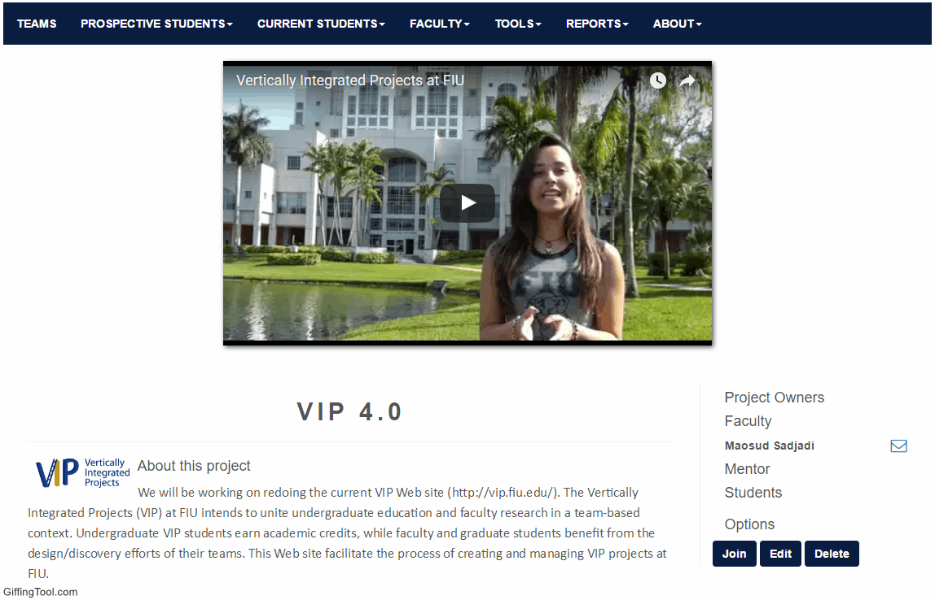
Demo: Sending Message

Slide 12
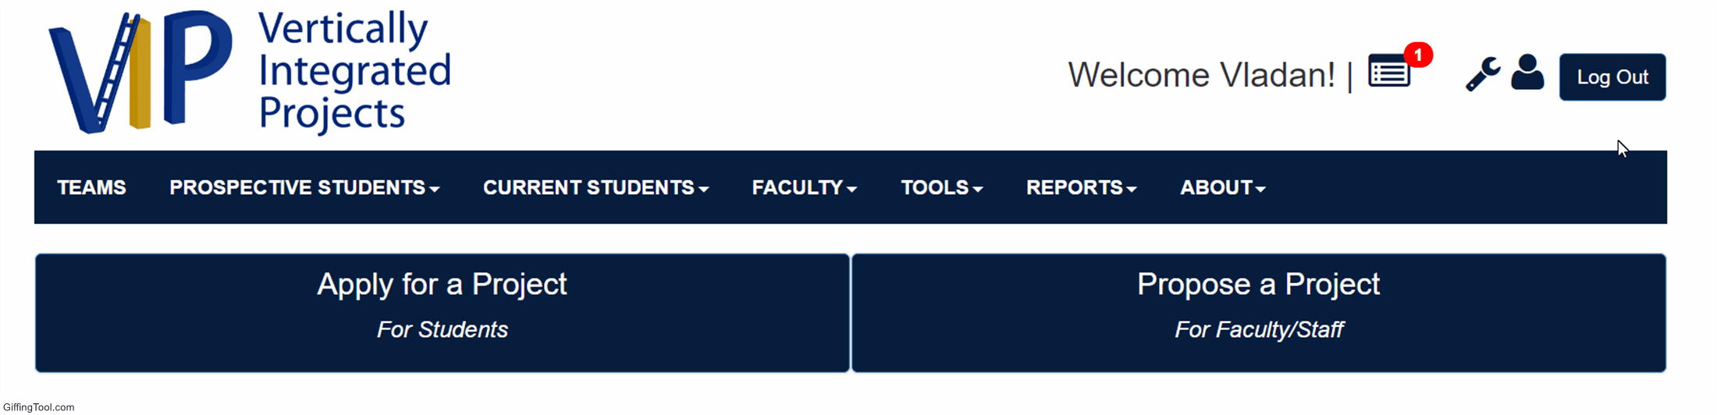
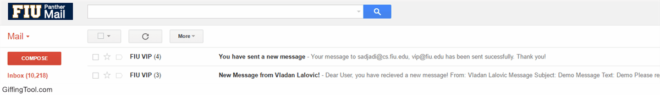
Demo: Receiving Messages
To-Do Notifications
Gmail Notifications

Slide 13
User Story #2 – Filters for Projects and Teams Page
Problem: Searching for projects is slow, and not user friendly.
Solution: Create project search filters.
Most Important Tasks:
Dynamically Refresh the Search Results - Instantly shows results!
Implement tons of useful filters – Find projects quickly!
What kind of filters?
“My Projects”
Open Projects
New Projects
Many more!

Slide 14
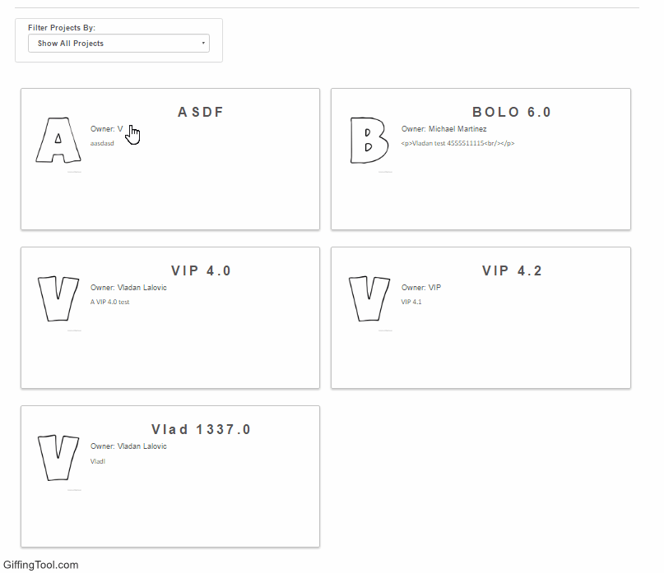
Demo: Dynamic Filters

Slide 15
User Story #3 – Creating & Maintaining Dev Server
Problem: No “live” testing environment for new code.
Solution: Create a “dev” server to test all changes.
Most Important Tasks:
Upload latest Experimental code every 24 Hours
Check the features for bugs
No bugs? Push code to live server.
Open new port in Linux
Dev runs on unique port – separate from live server.
Create separate database
Uses separate database instance.

Slide 16
User Story #4 – Fixing Issues with Existing Features
Problem: New/Experimental Code has many bugs. Some of them get forgotten – so they go unfixed.
Solution: Fix the bugs, then use GitHub’s BugTracker to change the bug’s status to “fixed”.
Most Important Tasks:
Create new entries in GitHub’s BugTracker for new bugs found during Dev Server tests.
Fix and test new code on the Dev Server.
Update BugTracker with the results of the new tests.
Benefits:
Worked on solving issues with almost every feature – gained a lot of project knowledge.

Slide 17
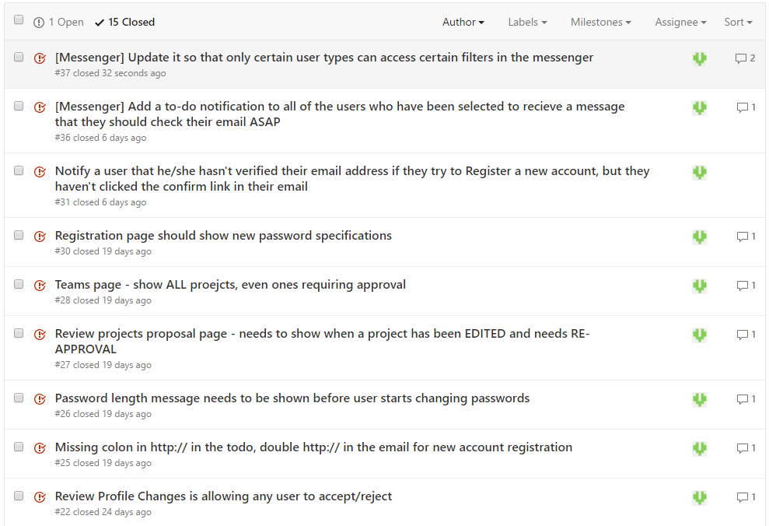
User Story #4 – GitHub BugTracker
GitHub BugTracker

Slide 18
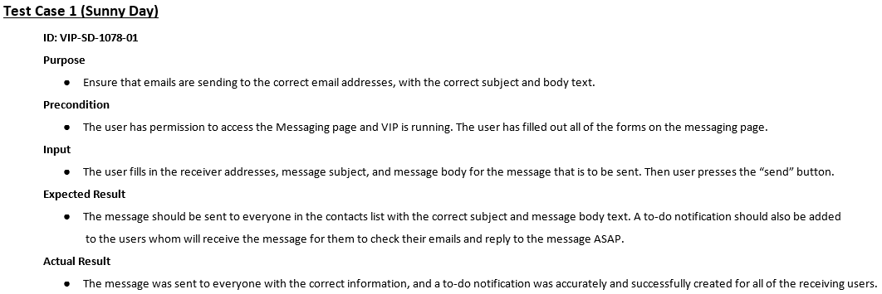
Sunny Day Test Case – Messaging System
Here I present a test case, one of many that shows that VIP development team prides itself in software testing.

Slide 19
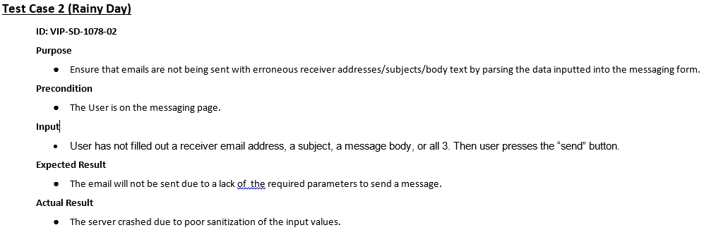
Rainy Day Test Case – Messaging System
Here I present a test case, one of many that shows that VIP development team prides itself in software testing.

Slide 20
In Conclusion
Summary: I’m very happy with my contributions to VIP. I believe the users will have an easier time communicating and searching for new projects to join.
Contact information:
Email: vlalo001@fiu.edu
Questions?
Thank You!

